Slide 1

ESAL 0580
Library Instruction Session
Melissa Svendsen

Slide 2
Learning Objectives
By the end of this class, you should:
1. Be familiar with library related vocabulary.
2. Understand the role of the library at TRU.
Recognize academic sources.
4. Find sources through the TRU Library.
Cite sources in APA style.
Format a paper in APA style.

Slide 3
1. Library Related Vocabulary

Slide 4
Glossary of Library Terms
Purpose:
To help you learn some of the specialized vocabulary that you need to use the library and do research at TRU.

Slide 5
Your Library PIN is _______.
a) the same as your library card number.
b) your birthday in the form: YYMMDD.

Slide 6
An article is a ______.
a) short piece of writing that was published in a journal, magazine or newspaper.
b) record in a database.

Slide 7
An abstract is ______.
a) a brief summary of the contents of a book or article.
b) a book about how to use the library.

Slide 8
The author of an article is the person who ______.
a) wrote it.
b) read it.

Slide 9
The subject of an article is ____.
a) what it is about.
b) the journal in which it was published.

Slide 10
Which of the following are Boolean Operators?
a) AND, OR and NOT
b) BUT, IF and OF

Slide 11
Which of the two following choices uses Search Terms?
a) Do video games help teenagers learn?
b) video games AND teenagers AND education

Slide 12
A Bibliographic Record is a______.
a) publication that contains information on a variety of topics.
b) record for book or article that contains all of the information necessary cite it.

Slide 13
If an article is available in full text, it is available to be ______.
a) checked out of the library
b) read online or printed.

Slide 14
If the library has an item online, it is______.
a) available to be read on a computer or iPad.
b) sitting on the shelf in the library.

Slide 15
If an article is available as a PDF file, it ______.
a) is available to be read or printed right way.
b) must be ordered from another library.

Slide 16
Interlibrary Loan is a way ______.
a) to access books and articles that the TRU library does not have.
b) to return books to the TRU library.

Slide 17
Your library card is the same as your ______.
a) campus card.
b) driver’s license.

Slide 18
A librarian is:
a) a nasty person whose main job is to make sure that you do not eat pizza in the library.
b) a nice person whose main job is to help you find books and articles.

Slide 19
2. The Role of the Library

Slide 20
The Library at TRU has two main roles:
1. To provide students and faculty with the resources that they need do their research.
2. To help students and faculty with their research.

Slide 21
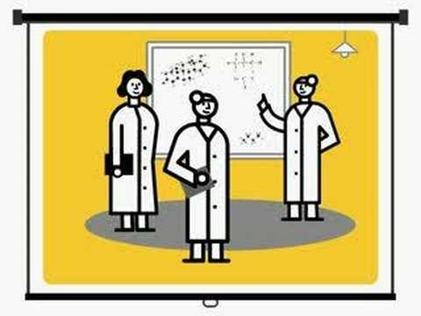
Video: Research as a Conversation

Slide 22
What kind of resources does the library have
The Library has …

Slide 23
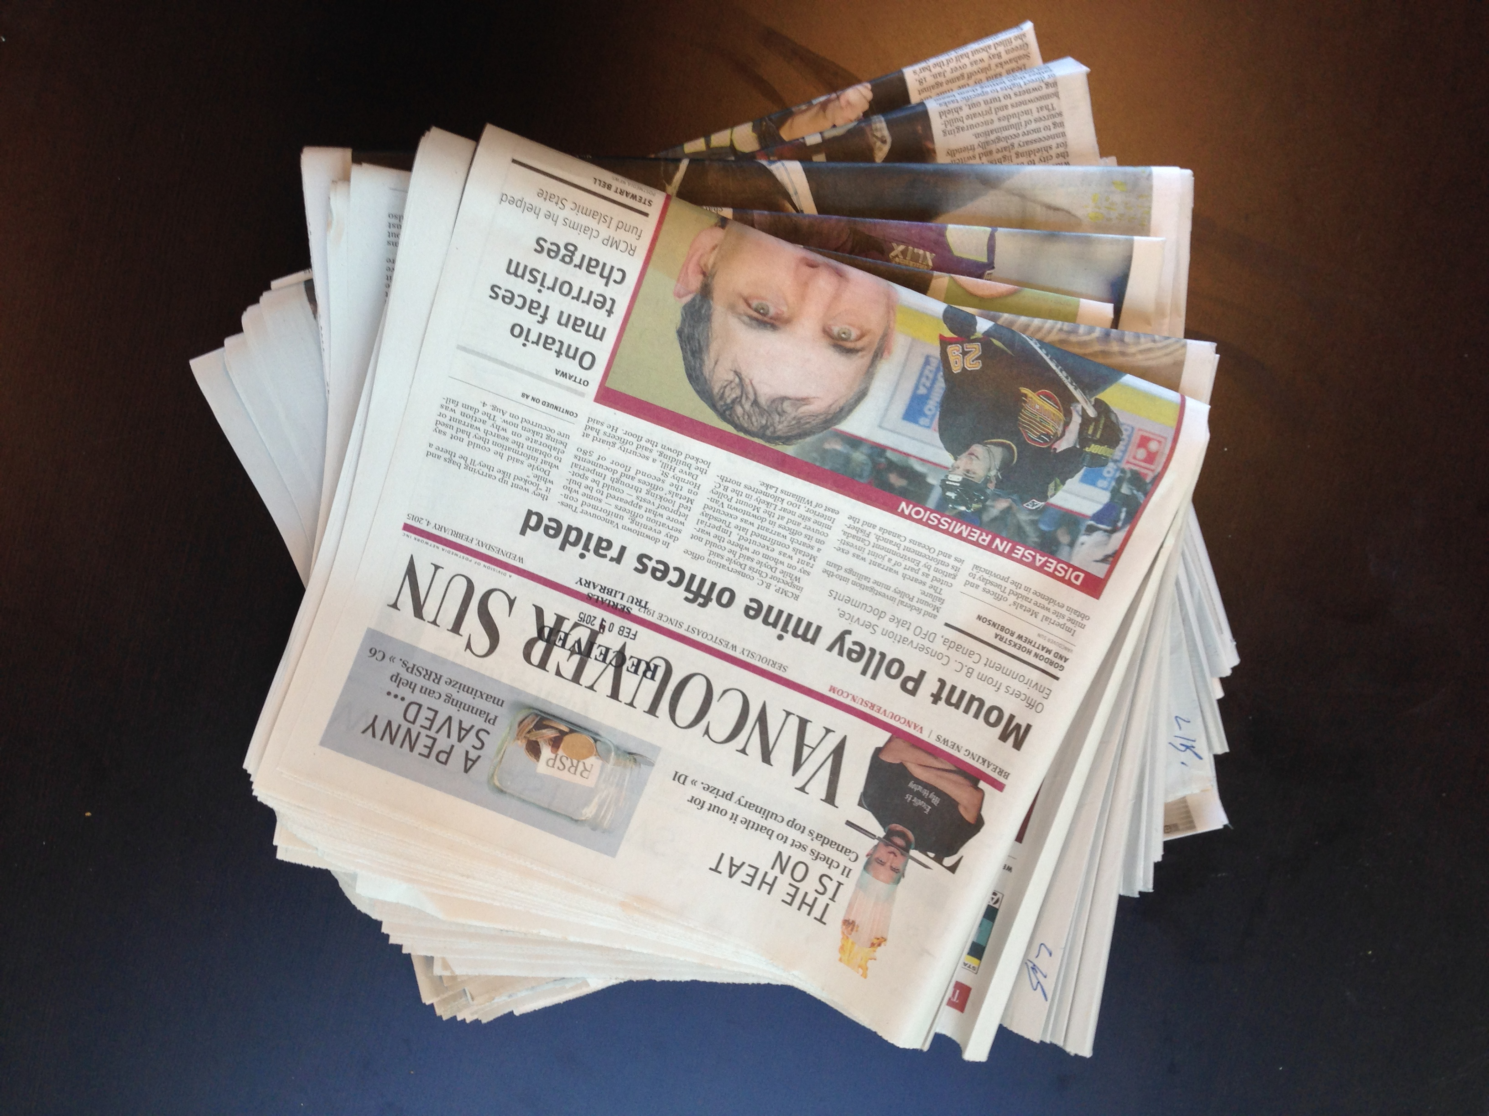
. . . newspapers

Slide 24
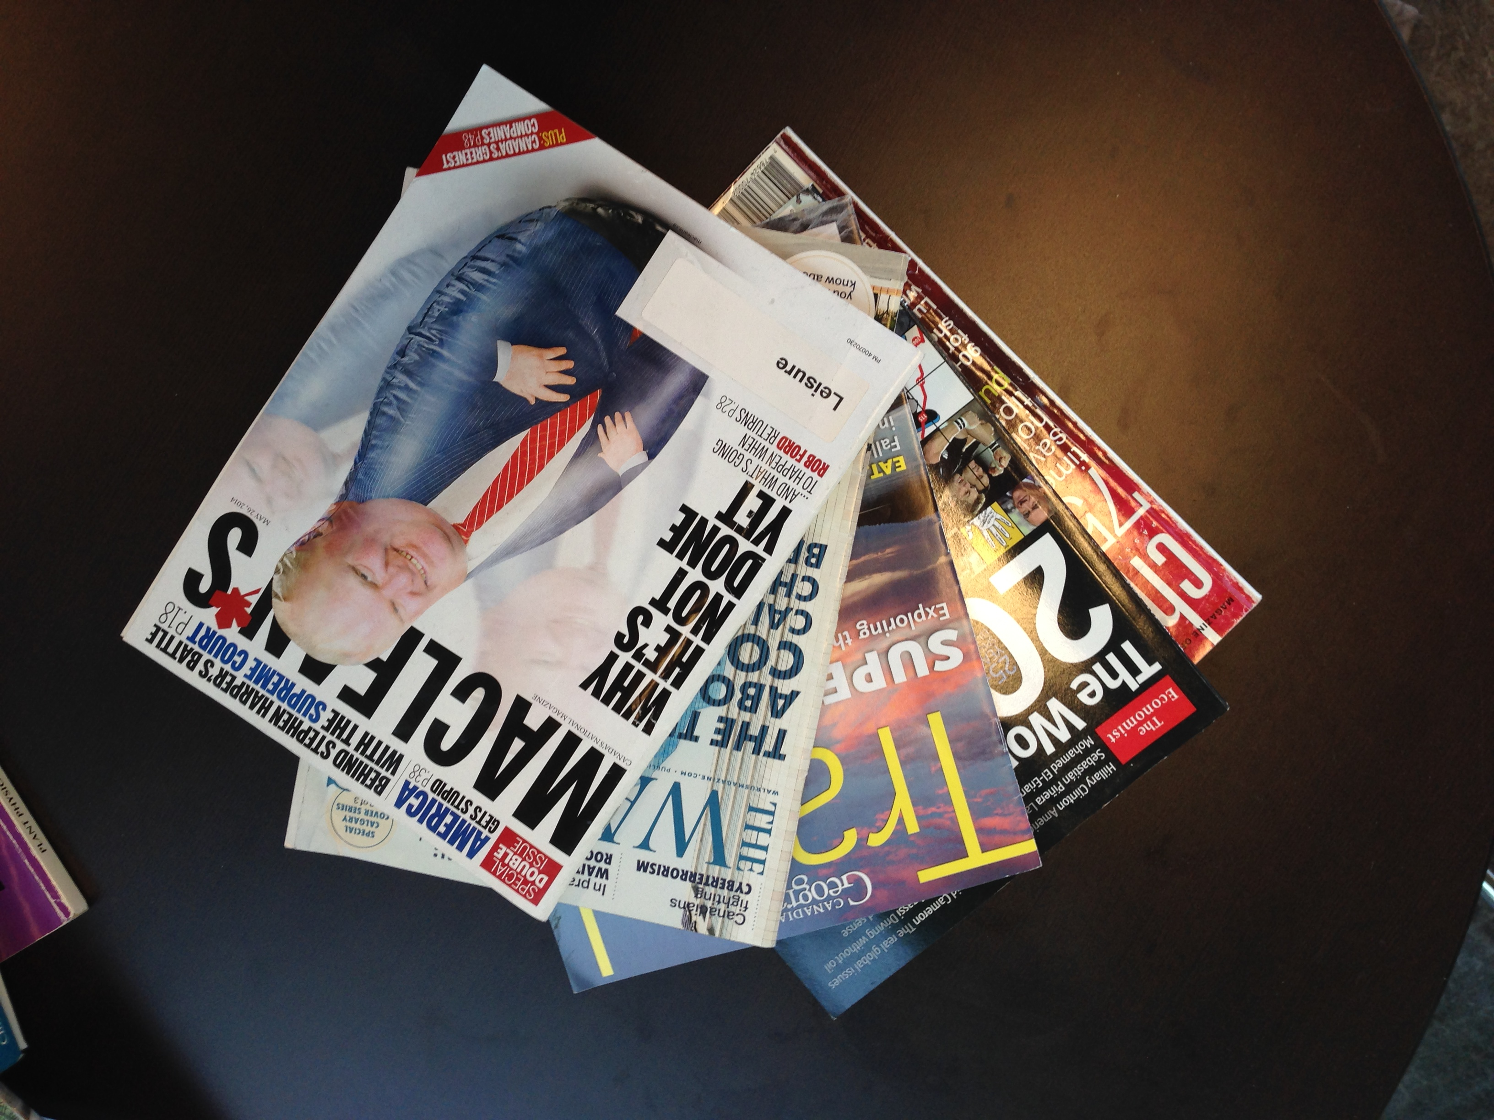
. . . magazines

Slide 25
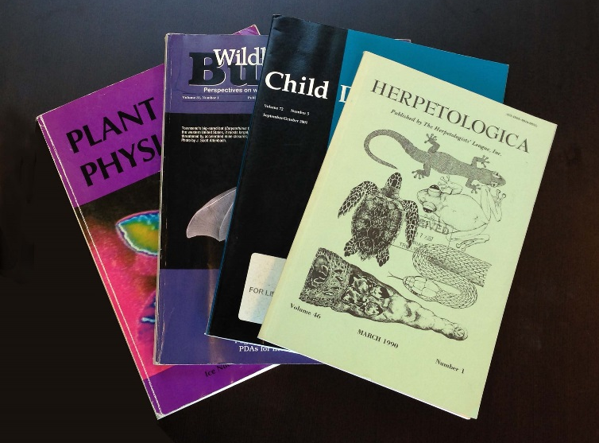
. . . academic journals

Slide 26
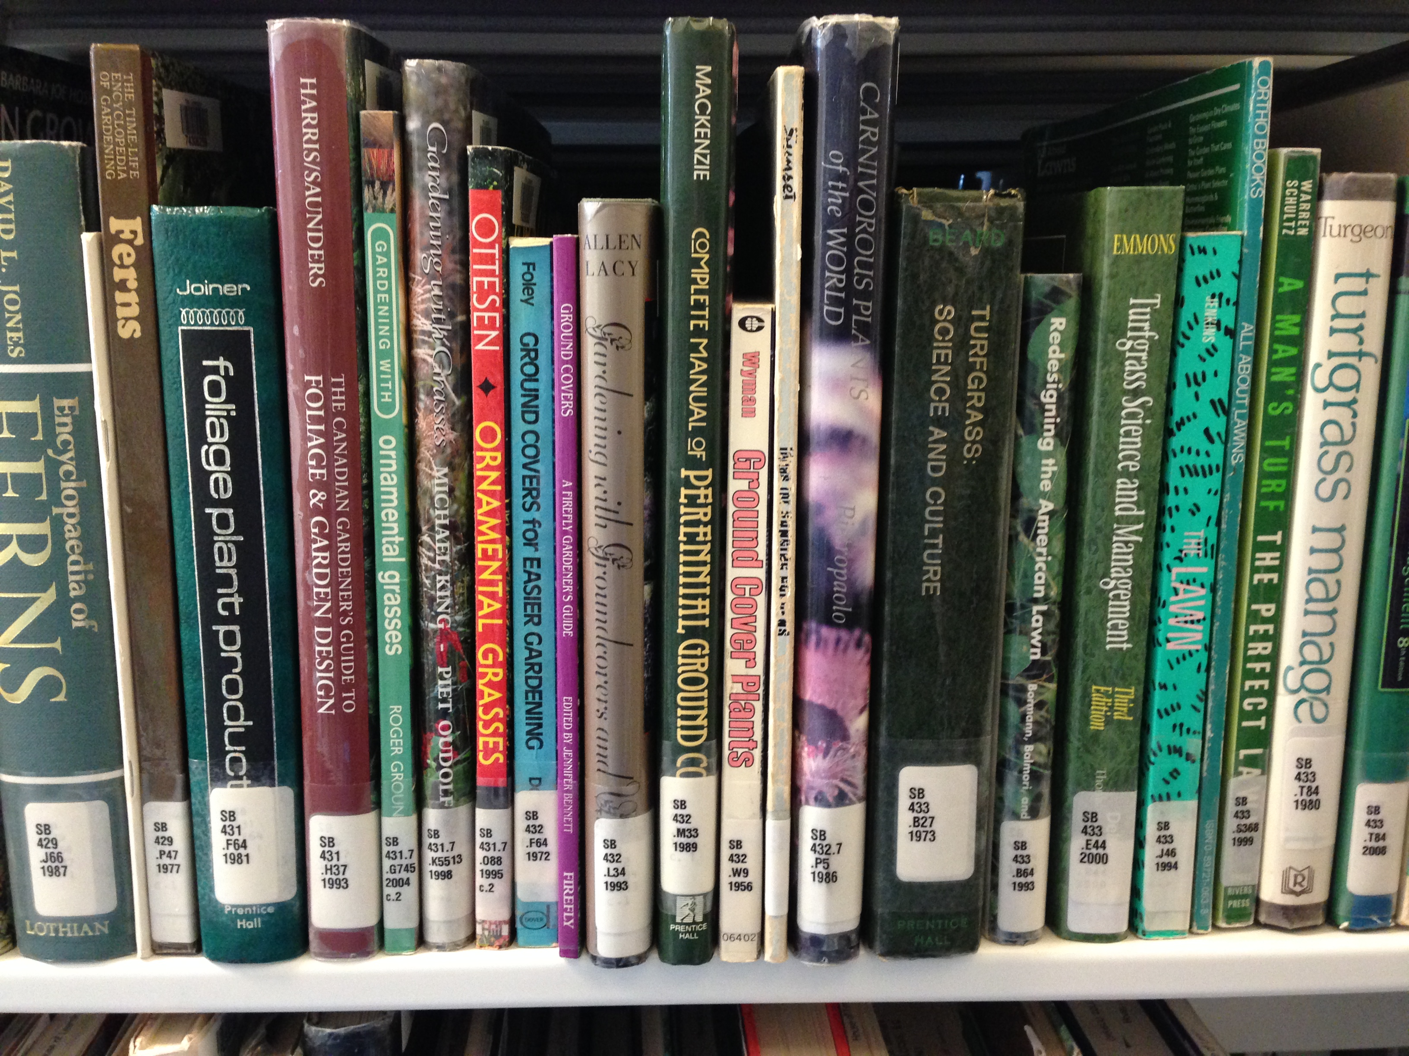
. . . books

Slide 27
Online Resources
Today, most of the libraries resources are available online from any computer.

Slide 28
Writing a Research Paper
Find academic sources.
Write the paper.
Cite your sources.

Slide 29
3. Academic Sources

Slide 30
Academic sources are ____.
a) written by journalists for professional writers for everyone to read.
b) written by academics for other academics to read.

Slide 31
Non-academic sources
Newspaper articles.
Magazine articles.
Some books.
Academic Sources
Articles in academic journals.
Some books.

Slide 32
Non-academic Articles
Tend to be short.
Tend to be visually interesting.
Are written by journalists.
Use everyday vocabulary.

Slide 33
Academic Articles
Tend to be long
Tend to be visually boring.
Usually have an abstract.
Are written by experts.
Use Specialized vocabulary
Have citations
Have a bibliography

Slide 34
Academic Sources
Are written by experts.
Have citations.
Have bibliographies.

Slide 35
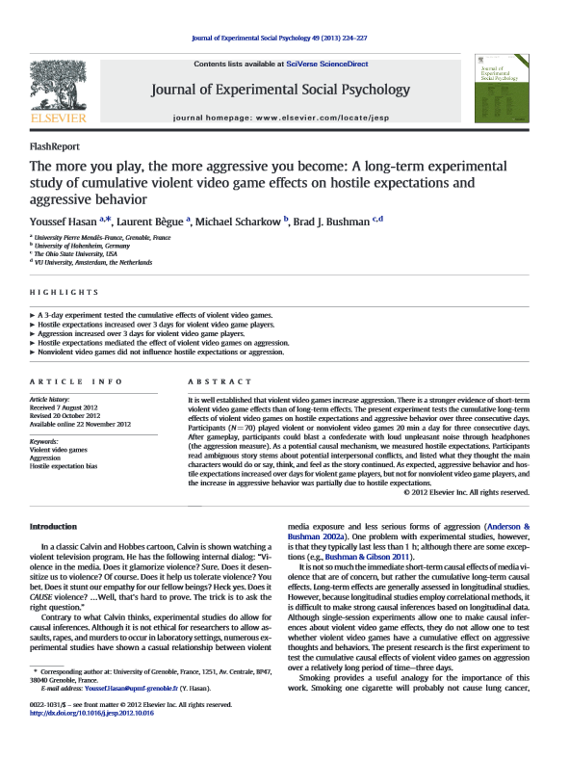

Slide 36


Slide 37
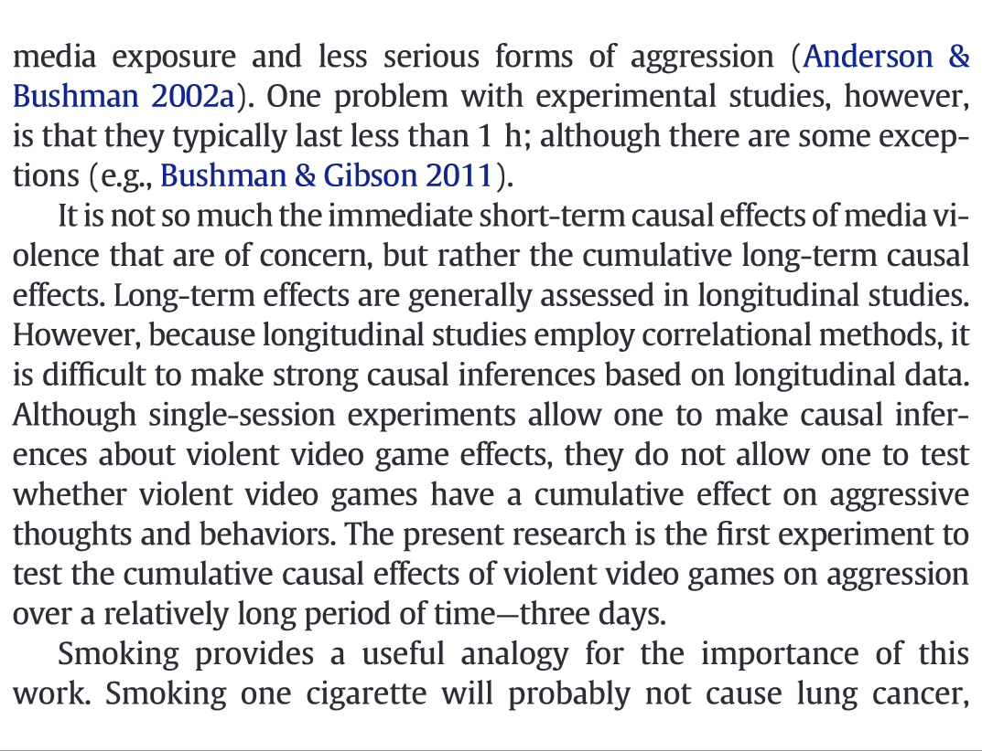

Slide 38
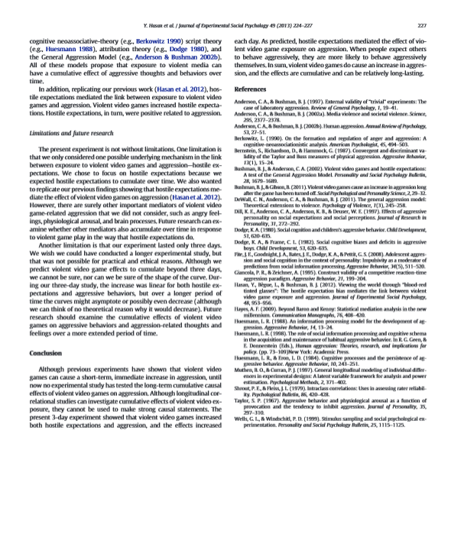

Slide 39
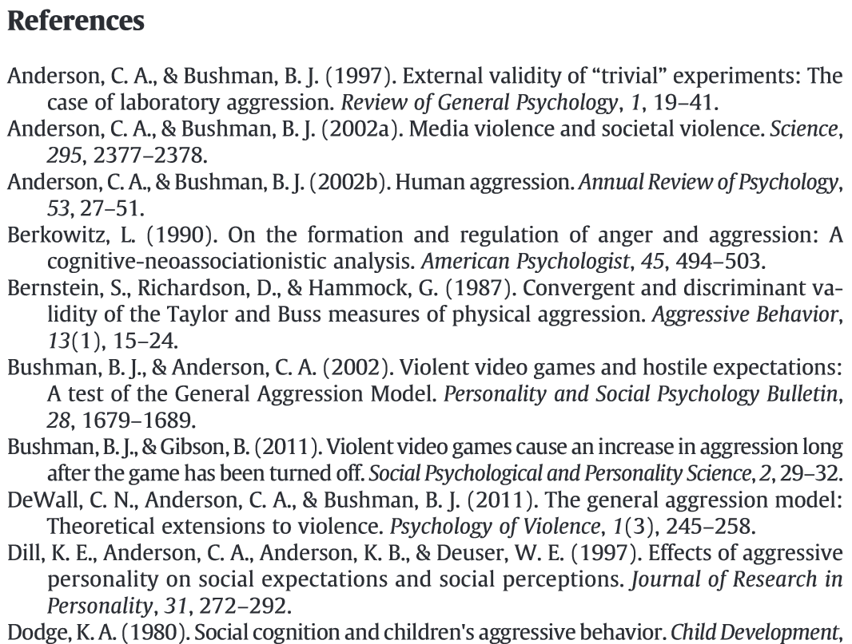

Slide 40
Exercise:
For each article in the folder, use the flowchart to determine if it is an academic source.
We’ll do the first one together…
Notes:
Students break into pairs and each pair get a folder containing the following articles:
DeLisi, M., Vaughn, M. G., Gentile, D. A., Anderson, C. A., & Shook, J. J. (2013). Violent video games, delinquency, and youth violence: New evidence. Youth Violence and Juvenile Justice, 11(2), 132-142.
Ferguson, C. J. (2011). Video games and youth violence: A prospective analysis in adolescents. Journal of Youth and Adolescence, 40, 377-391.
Ferguson, C. J. (2014). Is video game violence bad? Psychologist, 27(5), 324-327.
Hasan, Y., Begue, L., Scharkow, M., & Bushman, B. J. (2013). The more you play, the more aggressive you become: A long-term experimental study of cumulative violent video game effects on hostile expectations and aggressive behavior. Journal Of Experimental Social Psychology, 49(2), 224-227.
Jaffe, P. (2007, Spring 2007). Challenging the proliferation of media violence: A call to action for educators, parents, students and our communities. Education Today, 19, 24-27.
Peckham, M. (2013). Researcher says linking video games to gun violence is a 'classic illusory correlation'. Time.
Ultra-violent video games fuel aggression. (2004, Feb 19, 2004). Nanaimo Daily News.

Slide 41
Source
What kind of source is it?
Academic
Is it written
by an expert?
Does it
have a bibliography?
Does it have
citations?
Y
Y
Y
N
N
Has it been
reviewed by the author’s peers?
N
NOT
Academic
NOT
Academic
NOT
Academic
N
Y
NOT
Peer- Reviewed
Peer- Reviewed

Slide 42
Peer Reviewed Sources
Are reviewed by
the author’s peers.

Slide 44
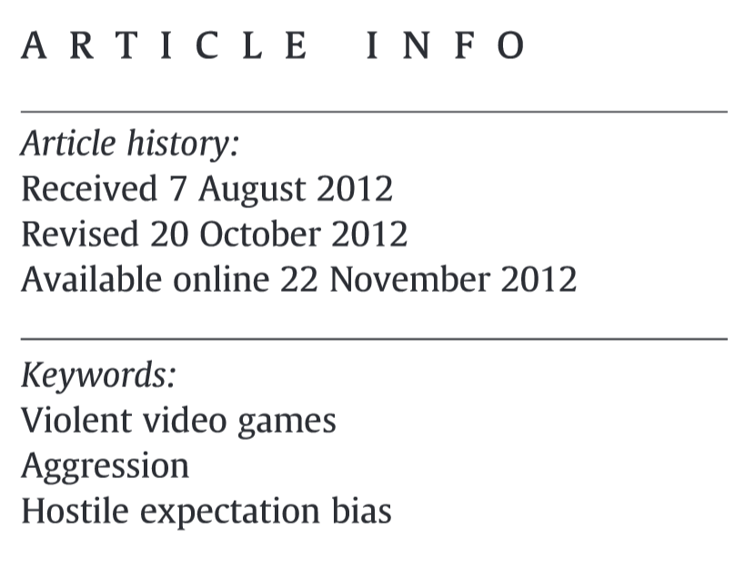

Slide 45
Exercise:
For each academic article in the folder, use the flowchart to determine if it is peer reviewed.

Slide 46
Source
What kind of source is it?
Academic
Is it written
by an expert?
Does it
have a bibliography?
Does it have
citations?
Y
Y
Y
N
N
Has it been
reviewed by the author’s peers?
N
NOT
Academic
NOT
Academic
NOT
Academic
N
Y
NOT
Peer- Reviewed
Peer- Reviewed

Slide 47
4. Finding Sources

Slide 48
Melissa’s Question:
Do video games contribute to violent behaviour in teenagers?

Slide 49
Search Terms:
words or phrases that tell the computer what to search for.
For example:
“video games”
violence
teenagers

Slide 50
Boolean Operators:
special words that tell the computer how to combine search terms.
The Boolean operators are:
AND
OR

Slide 51
Boolean Exercise:

Slide 52
Boolean Exercise: AND
AND

Slide 53
Boolean Exercise: AND
AND
AND

Slide 54
Boolean Exercise:

Slide 55
Boolean Exercise: OR
OR

Slide 56
Boolean Exercise: OR
OR
OR

Slide 57
Boolean Exercise: AND
(
)
OR
OR
AND

Slide 58
Search Terms:
“video games”
AND
violence
AND
teenagers

Slide 59
http://www.tru.ca/library.html
Notes:
Demonstration Search I
“video games” → 185,796
“video games” AND violence → 20,669
“video games” AND violence AND teenagers → 4,287
("video games" OR "computer games") AND violence AND teenagers → 5,215
("video games" OR "computer games") AND violence AND (teenagers OR adolescents) → 10,336
1. Violent Online Games Exposure and Cyberbullying/Victimization Among Adolescents. → PDF
Limit to magazines and news → 2,197
1. MIND GAMES. → HTML
2. More than Child's Play? →HTML, PDF -- Discuss difference between HTML and PDF formats
Demonstration Search II
“video games” → 185,796
“video games” AND violence → 20,669
“video games” AND violence AND teenagers → 4,287
("video games" OR "computer games") AND violence AND teenagers → 5,215
("video games" OR "computer games") AND violence AND (teenagers OR adolescents) → 10,336
1. Violent Online Games Exposure and Cyberbullying/Victimization among Adolescents. → PDF
22. Internet use and video gaming predict problem behavior in early adolescence → Science Direct
29. Demolishing the competition: The longitudinal link between competitive video games, competitive gambling, and aggression → Where can I get this? → Springer

Slide 60
5. Citing Sources

Slide 61
APA Style
A style of citing sources according to the Publication Manual of the American Psychological Association.

Slide 62
Parts of an APA Citation:
Author, A. (Year). Title of article: Subtitle of article. Title of Journal, volume (issue): page range. doi: xxxxxxxxxxxxxxxxx

Slide 63

Issues & Volumes:
An issue is a single publication of a journal:
A volume is made up of all of the issues that are published in a calendar year:

Slide 64
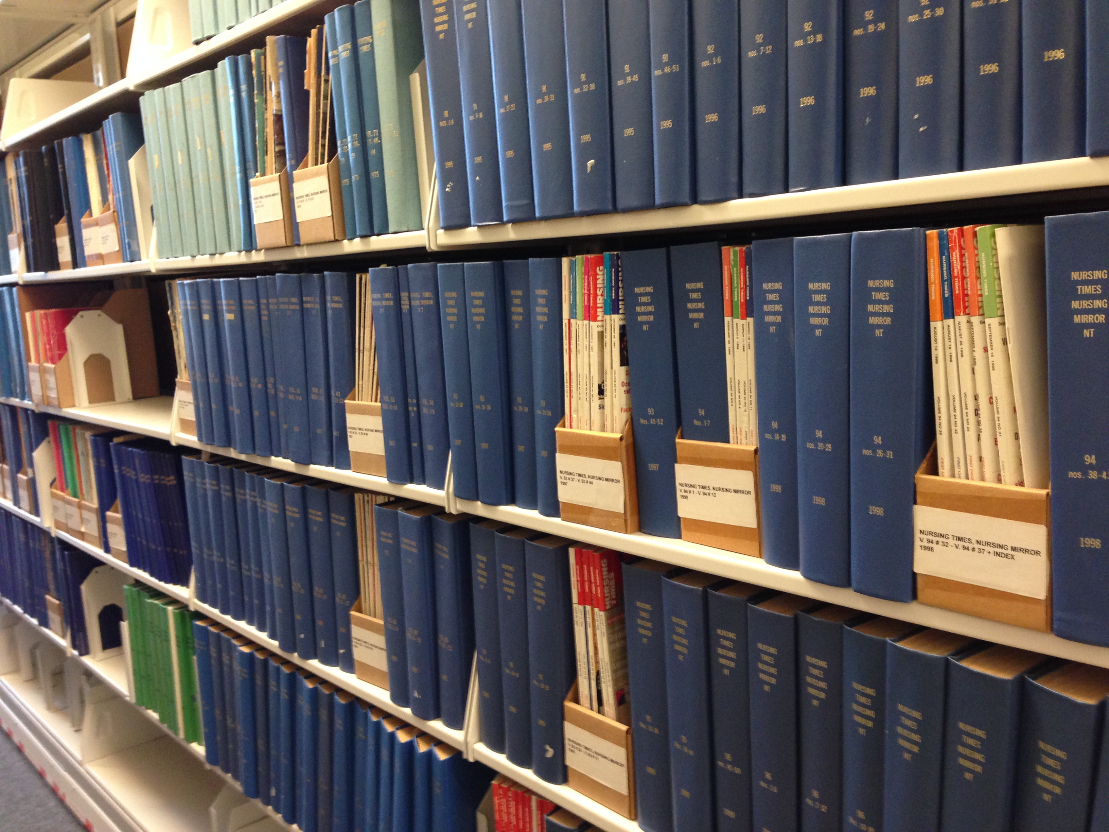
Notes:
Why volume, issue and page numbers used to be important for finding articles in journals!

Slide 65
Example of an APA Citation:
Ferguson , C. J. (2011) Video games and youth violence: A prospective analysis in adolescents. Journal of Youth and Adolescence, 40 (4): 377-381. DOI: 10.1007/s10964-010-9610-x

Slide 66
Proofread: v. To slowly and carefully read through a text in order to find and correct mistakes.

Slide 67
What kind of mistakes?
Punctuation
Capitalization
Italicization
Also check for things that might have been left out, like DOIs and URLs.

Slide 68


Slide 69
Exercise: Proofreading APA References

Slide 70
6. Formatting a Paper in APA Style

Slide 71
APA Style
A style of formatting papers and citing sources according to the Publication Manual of the American Psychological Association.

Slide 72
APA has two parts:
General formatting of paper
Formatting of citations and references.

Slide 73
There are a lot of very specific rules for formatting a paper in APA style.
The font should be 12 pt. New Times Roman or Courier.

Slide 74
Font: n. the shape and size of the text.

Slide 75
Shape:
Segoe Semibold
Comic Sans
New Times Roman
Courier

Slide 76
Size:
48 pt. New Times Roman
36 pt. New Times Roman
24 pt. New Times Roman
12 pt. New Times Roman

Slide 77
The entire paper should be double spaced.
This text is double spaced, which means that there is text on every second line, leav-ing a lot of space between the lines.

Slide 78
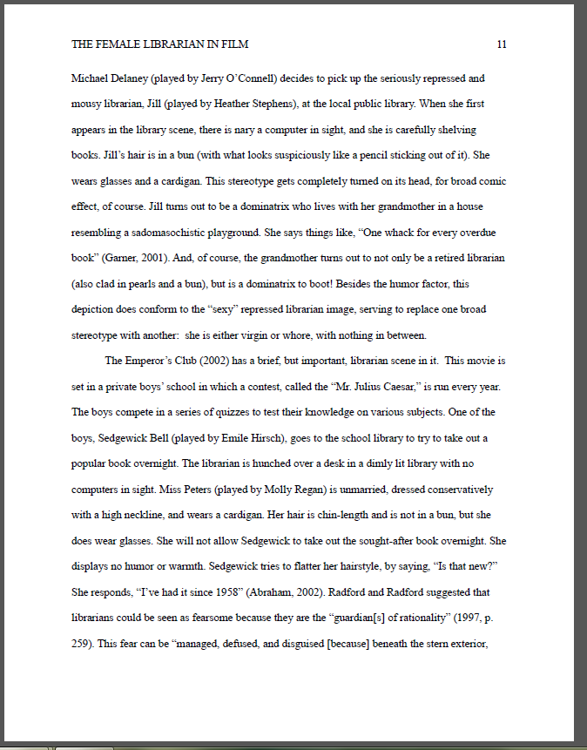
All four margins should be set to 1 inch (2.5cm).

Slide 79
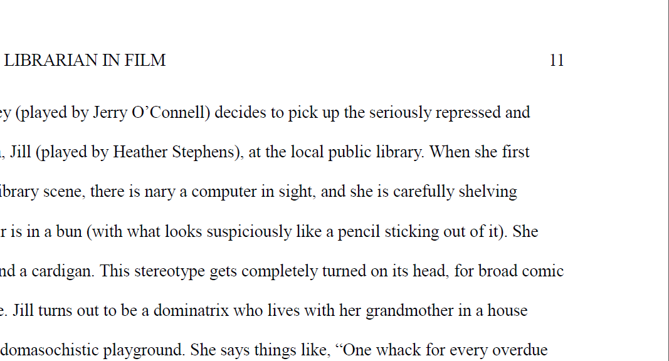
The pages should be numbered with Arabic numerals in the top right corner.

Slide 80
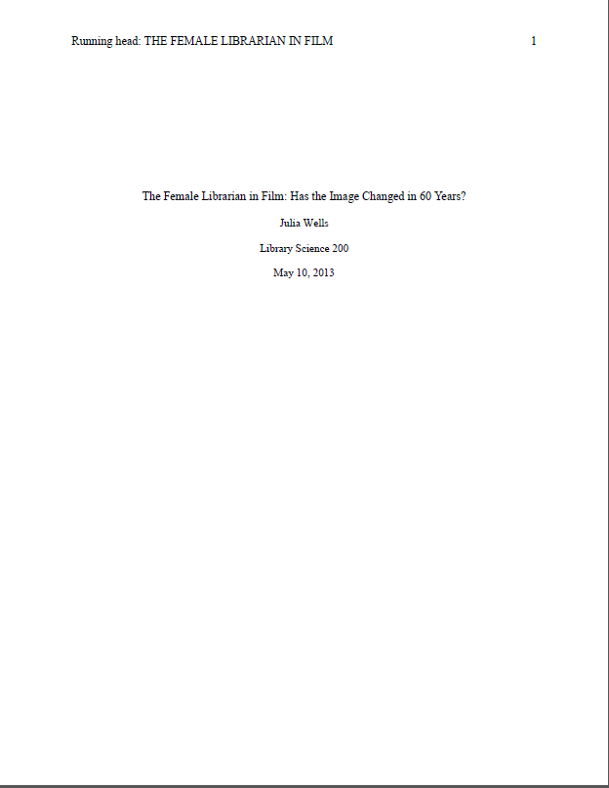
There should be a title page.

Slide 81
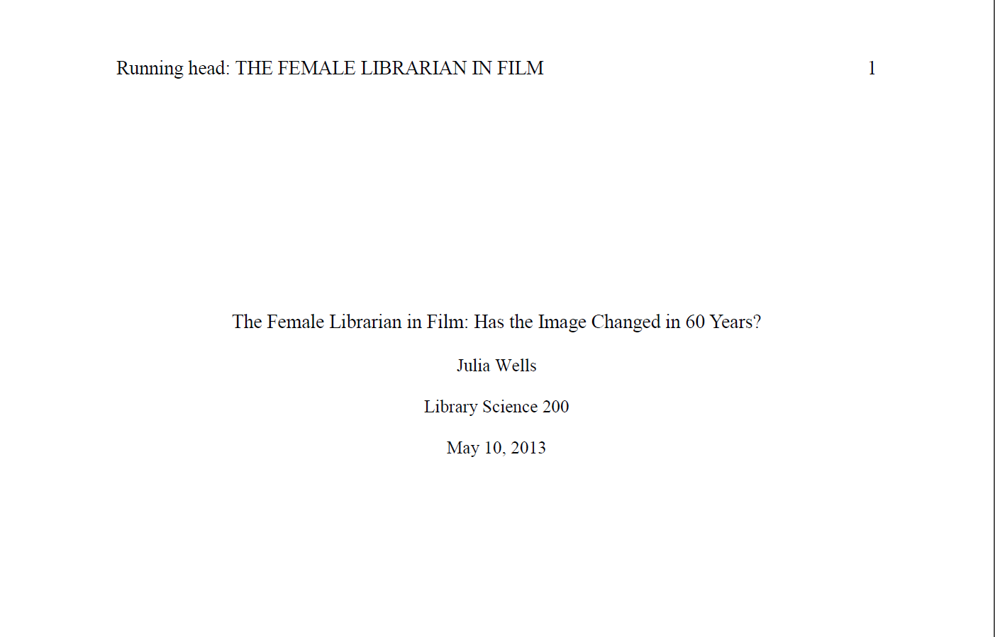
The title of the paper should be centred in the top half of the title page.

Slide 82
The title should have a running head.

Slide 83
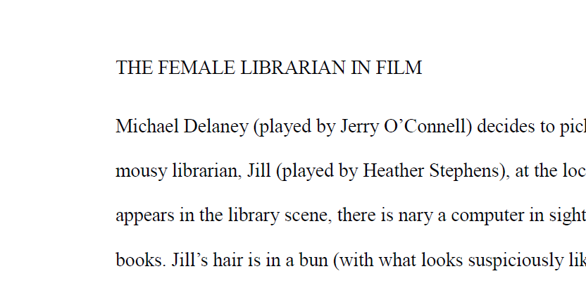
The running head on the rest of the pages should be different from the running head on the title page

Slide 84
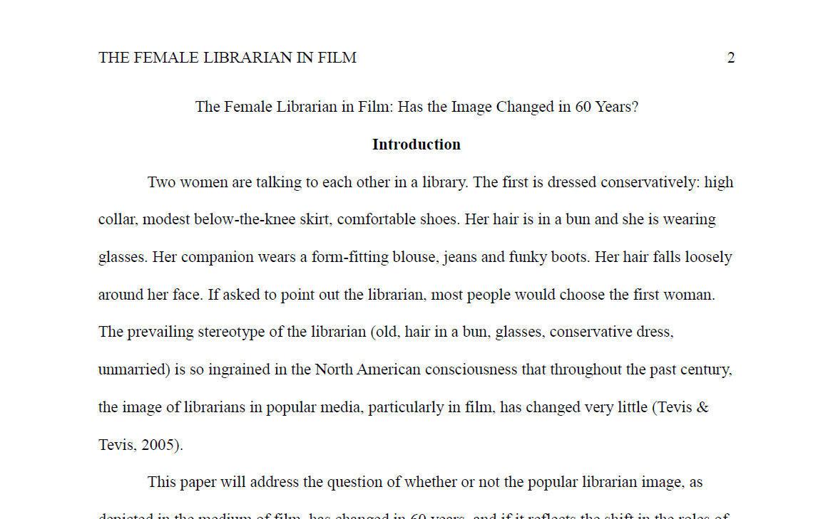
The title should be repeated at the top of the first page.

Slide 85
We can set all this stuff up in a Word Document…
Or we can use a ready made template.

Slide 86
Template: n. a computer file with the defaults set to create a certain type of document, such as a paper formatted in APA style.

Slide 87
Default: n. what happens automatically if a feature is not changed.
Notes:
Demonstrate cutting and pasting text from a paper formatted with the Word default style into the Word APA template. Then have the students do the same thing with a paper of their own.

