Slide 1

Performance of Information Literacy Task by Librarians, Domestic Students and International Students
Melissa Svendsen
msvendsen@tru.ca
Learning at Intercultural Intersections, 2015

Slide 2
The Problem
Learning Objectives for Information Literacy Instruction
60 minutes
Students will be able to:
Contrast the catalogues, article databases, and Internet search engines.
Identify newspaper, magazine and journal articles online and in print.
Distinguish between academic and non-academic articles.
Construct a search strategy using search terms and Boolean operators.
Perform a keyword search in the catalogue
Perform a keyword search in Academic Search Complete.
Export APA citations from Academic Search Complete.
Identify the major components of a bibliographic record.
Determine whether TRU has access to the full-text of an article.
Locate sources of help on the library website.
Notes:
These are learning objectives for a typical class on information literacy. This is also a lot to get through in 60 minutes, even with native speakers. With ESL students, it just didn’t seem workable, so I knew that I needed to scale back my expectations of what the students could learn in a single session. On the other hand, all of these objectives are important, so if I were going to jettison any of them, I would need a better reason than just a subjective impression that I was leaving the class behind.

Slide 3
The Literature
ESL students and academic libraries
Long on advice, but short on specifics, empirical findings
Studies of complicated phenomena in a very small number of subjects

Slide 4
The Method
I timed individuals as they read a bibliographic record on a computer screen and answered multiple choice questions with paper and pencil.
Three groups:
Library staff (librarians and library technicians)
L1 Students
L2 Students

Slide 5
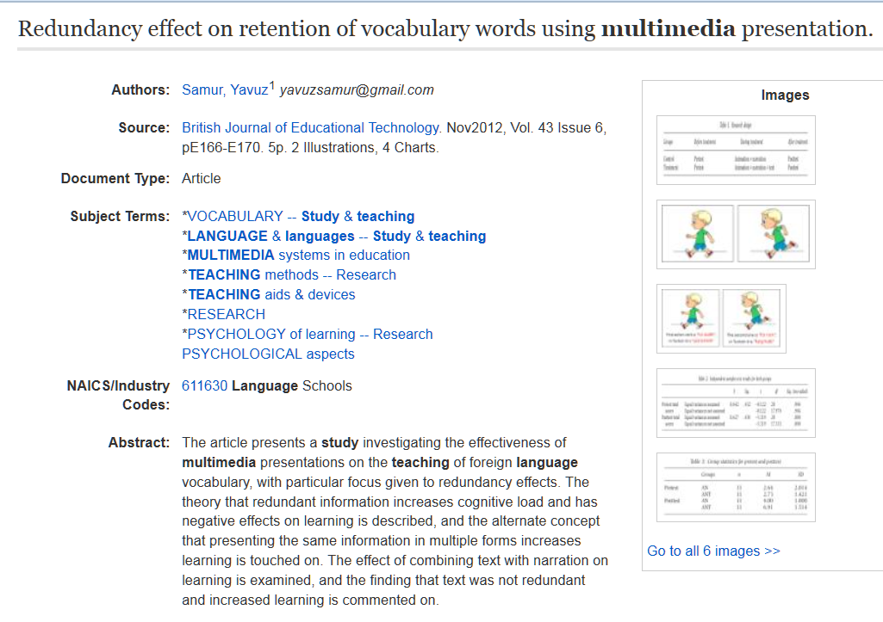
A Bibliographic Record in Academic Search Complete

Slide 6
Sample Multiple Choice Questions
For each question, select the best answer:
1. In what journal was this article published?
a) British Journal of Educational Technology
b) Educational Technology Today
c) American Journal of Education and Technology
***
5. Which of the following searches would be most helpful
in finding similar articles?
a) teaching aids & devices AND research
b) vocabulary AND multimedia
c) language AND psychological aspects

Slide 7
Inverse Efficiency Score
The higher the score, the less efficient the performance of the task, e.g.:
Time / | Accuracy | IES
400 | .80 | 500
Townsend, J.T., & Ashby, F.G. (1978). Methods of modeling capacity in simple processing systems. In J. Castellan & F. Restle (Eds.), Cognitive theory. Vol. 3. (pp. 200-239). Hillsdale, N.J.: Erlbaum.
Townsend, J.T., & Ashby, F.G. (1983). Stochastic modeling of elementary psychological processes. Cambridge: Cambridge University Press.

Slide 8
The Results

Slide 10
Notes:
In designing this experiment, I failed to take into account the following:
First, it is perfectly possible for an individual to have native-speaker competency in more than one language. A number of the participants were young people from Vancouver who gave their first language as German or Punjabi or Cantonese, but who spoke English with distinct Western Canadian accents. These participants patterned with the native speakers of English.
Second, “English” itself is not necessarily a clearly defined concept, in that there is no firm line dividing the dialect of English spoken in a country such as Nigeria from a creole based on English. Thus, one can shade imperceptibly into the other, so that an individual from Nigeria may consider English to be his or her native language without necessarily being fluent in English as it is spoken in Canada. Several participants in this study who had been born and educated in Nigeria clearly patterned with the non-native speakers of English.
Both these situations are accounted for if student participants are divided into domestic and international students, rather than native and non-native speakers of English. (There were no participants in this study from countries such as the UK or the US, where the standard dialect of English is very similar to that spoken in Canada.)

Slide 12
The Solution
Learning Objectives for ESAL 0580
60 minutes
Students will:
Be familiar with library related vocabulary.
Understand the role of the library at TRU.
Recognize academic sources.
Be able to find sources through the TRU Library.
Be able to cite sources in APA style.
Notes:
These are learning objectives for that I currently use when presenting ESAL 0580. As you can see, it is drastically paired down, but I think that the students actually get more out of the class than they did when I tried to pack more in.

Slide 13
Directions for Future Research
More data on ESL/International students
  Age of first exposure to English
  Context of exposure – e.g., Canada vs. India
  Linguistic distance of native language from English
Students with learning disabilities
More complex tasks, e.g.:
  Formulating and implementing search strategies
  Evaluating sources
  Summarizing and paraphrasing content

