Slide 1
Frames within Frames
An Exploration of the
Assumptions Implicit in the ACRL’s
Framework for Information Literacy for Higher Education¹
^{1.} The frames discussed here are adapted from the Association of College and Research Libraries’ Framework for Information Literacy for Higher Education (ACRL MW15 4.1). Retrieved from http://acrl.ala.org/ilstandards/wp-content/uploads/2015/01/Framework-MW15-Board-Docs.pdf
Notes:
When I read the Framework, the first thing I thought is that we are expecting lot of our students -- and the second thing I thought is that we are assuming a lot about our students.

Slide 2
The Framework
is very ambitious, with a focus on higher order skills.
assumes a particular kind of student, with a particular set of pre-existing dispositions.
reflects an education system that is designed for students who share a sociocultural background with their professors.
Notes:
International students do not necessarily share the assumptions that underlie the framework, and all students – domestic as well as international -- will benefit by having these assumptions made explicit.
In my information literacy workshops, I see students being asked to run before they can walk. In particular, many of them are being expected to view knowledge, authority, and even what it means to be educated person in culturally unfamiliar and sometimes uncomfortable ways.

Slide 3
If we are to serve all of our students, and in particular our international students, it is critical that we:
uncover the implicit assumptions that underlie the Framework.
be prepared to teach these assumptions directly.
Notes:
I’m using “assumption” in the neutral sense of “something taken for granted.” An assumption is just something that’s assumed: it can be accurate or inaccurate, benign or pernicious. But the important thing about an assumption is that it’s tacit, and because it’s tacit, it’s easy to forget that not everyone shares it. And then when we do discover that not everyone shares it, we are tempted to see this difference as a deficit.

Slide 4
In this talk, I will:
discuss each frame in turn, attempting to uncover the implicit assumptions that underlie it.
argue that, to the extent that we are able to make these implicit assumptions explicit, we will better serve our international students.

Slide 5

Frame 1
Authority is constructed
and contextual.
Authority is constructed
in that different communities
recognize different types of authority.
Authority is contextual in that different information needs require different levels of authority.

Slide 6
Assumption:
Authority is contested.
Authority is contested in
that reasonable people can
disagree on the assignment of
authority, both within and among communities.
Asserting that an authority figure is mistaken is not necessarily a sign of disrespect.
Notes:
This is a particularly difficult concept for those international students who come from countries with authoritarian social and political systems. It is often quite difficult for them to understand and internalize the idea that even authoritative sources of information -- such as teachers, government officials, and authors of journal articles – are subject to challenge.
For this reason, students from these countries often do not understand why they must consult multiple sources in their research, why one source representing one point of view is not enough. So they will find one apparently authoritative source and essentially crib from it, because that is what they have been taught to do. Synthesizing different perspectives and forming one’s own opinion is a real challenge for many students, but it is particularly difficult for some international students.

Slide 7
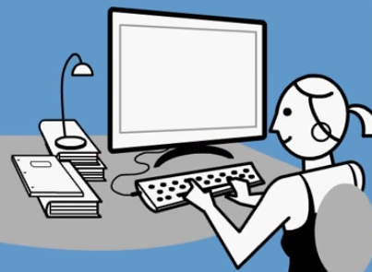
Frame 2
Information creation is a process.
Information creation is a
process that occurs within a particular context.
The iterative process of researching, creating, revising, and disseminating information varies, and the results reflect these variations.

Slide 8
Assumption:
Information creation is contingent.
Information creation is
contingent upon social, cultural and economic factors.
If these factors were different, then the information created would be different.
Notes:
In other words, we know what we know because people over time have asked certain questions and pursued particular lines of inquiry.
As an example, we know a lot about the daily lives of slaves in the United States because the Roosevelt administration sent young people working for the Federal Writers' Project to interview elderly freedmen and women. If the Federal Writers’ project hadn’t existed, we wouldn’t have those stories. So the particular social and economic factors that led to the creation of the Federal Writer’s project inform our understanding of slavery. In order to understand that the recording of these testimonials was influenced by the context in which it was done, it is necessary to first understand that it might not have happened at all.

Slide 9
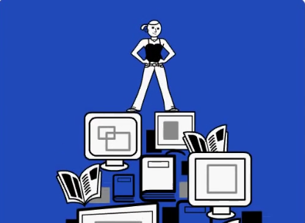
Frame 3
Information has value.
Information has value:
as a commodity.
as a means of influence.
as a means of education.
as a means of understanding the world.

Slide 10
Assumption
Information varies in quality.
Information sources vary in
currency, completeness and reliability.
Information sources of various degrees of quality serve various purposes.
Notes:
So the quality – and thus the value -- of an article published in a scientific journal will be very different from the quality of a blog post published on the website of an environmental organization. The concept that information varies in quality is important – not just for understanding why care must be taken in the selection of sources, but also in understanding why it is important to cite those sources.

Slide 11
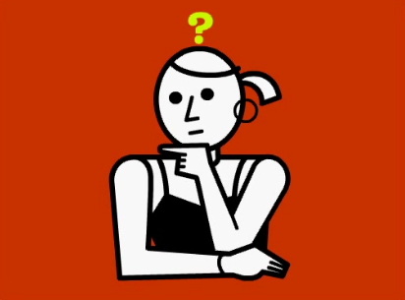
Frame 4
Research is inquiry.
Research is an iterative
process that involves asking
new and/or increasingly
complex questions that develop additional lines of inquiry.

Slide 12
Assumption:
Asking questions and finding
answers are important parts
of acquiring knowledge.
Knowledge must be actively constructed by individuals using many sources.
It is unlikely that all of the answers to a question will be found in one place.
Individuals’ opinions matter and may even influence the answers that they find.
Notes:
Knowledge is not a set of facts and concepts handed down by a single source of authority, such a teacher or government official. Instead, it requires that students ask questions and actively seek out answers to those questions. This is particularly a concern with international students, many of whom come from education systems in which rote memorization is emphasized and asking questions is discouraged.
I tell my students that at a Canadian university, it is not enough to simply learn information, but instead they must go out and find information from various sources and synthesize it into a coherent whole in the form of a research paper– and a that significant part of their grades are going to depend on their doing this well.
This another thing that international students sometimes find hard to grasp, the fact that research involves gleaning information from multiple sources. So a student who is writing about the need for halal food options on campus is unlikely to find articles specifically about halal food options on campus. But she is likely to find articles on a) the challenges of providing diverse food options on campus and b) the importance of halal food to Muslims living in the West. Her task is to read both sets of articles, synthesize the information they contain, and add her own perspective to create new knowledge.

Slide 13
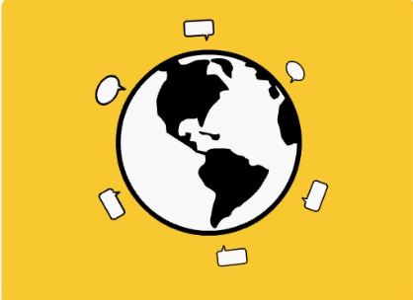
Frame 5
Scholarship is a
conversation.
Communities of scholars
engage in sustained discourse that results in new insights and discoveries emerging over time.

Slide 14
Assumption:
Reasonable people can disagree.
Asserting that someone is mistaken
is not a sign of disrespect.
Honest mistakes are an inevitable part of the process of creating knowledge, so being wrong does not necessary involve loss of face.
Notes:
Again, this is a particularly difficult concept for international students who come from authoritarian countries. It is very difficult for them to understand that it is OK -- even encouraged -- to disagree with other people so long as they support their own ideas with facts and reasoned arguments. This is how knowledge is built. It’s what people do at universities.
This is a tricky concept because of course it doesn’t apply across the board. There are constraints on who can disagree with whom and how they go about doing it. But the ideal of academic discourse is that disagreement welcomed, even if individual academics don’t always live up to this ideal. And students need to understand how the system is supposed to work before they can recognize when it isn’t working that way.
In addition, even when we don’t live up to this ideal, it is necessary to maintain the pretense of doing so because it is important to our self- concept as academics. I think of this as being similar to how, in a low-social-distance society like Canada, people often interact as equals without actually being equals, either materially or socially. So a student from a high-distance society may be surprised to see the dean chatting with the janitor, but the dean is still the dean and the janitor is still the janitor, even if both have a lot invested in interacting as if they were equals because it supports their self-concept of themselves and their society.
Similarly, at the end of the day, students’ opinions count for much less than professors’, but most professors will expect students to express opinions anyway. This sometimes leads to the what I call the graduate student’s dilemma – the need to come up with a thesis that is original enough to have merit but not so original as to seriously threaten your supervisor’s professional identity.

Slide 15
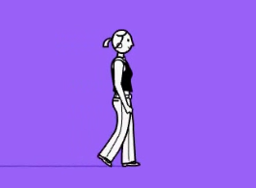
Frame 6
Searching is strategic exploration.
Searching for information is
an iterative process that requires the evaluation of information sources and the ongoing pursuit of new sources.

Slide 16
Assumption:
Understanding the world
requires a skeptical attitude
and an open mind.
It is not enough to master a set of facts about the world as presented by an authority figure.
All human knowledge is incomplete and therefore subject to ongoing re-analysis.
Notes:
This connects to a number of the earlier assumptions, including the idea that authority is contested, the idea that information creation is contingent on social, cultural and economic factors, and the idea that reasonable people can disagree.
If information is contested, and if its creation is the result of a process that is influenced by things other than the disinterested pursuit of the truth, then there is no fixed point at which the process of information creation is complete. So both the process of creating information and the process of discovering it are necessarily ongoing.

Slide 17

Summary
The following assumptions underlie the Framework:
Authority is contested.
Information creation is contingent.
Information varies in quality.
Asking and answering questions is important.
Reasonable people can disagree.
Understanding the world requires openness and skepticism.
Notes:
Many of our students share these assumptions when they come to university – which is why the Framework assumes rather than explicitly states them – but we need to keep in mind that not all of our students come from the same cultural background.

Slide 18

Citation and Plagiarism
International students often introduce a fact or concept with:
“Everyone knows that…”
or
“There is no disputing that …”
Notes:
Nowhere is this more important than in matters relating to citation and plagiarism....
So I tell then that no, everyone does not know that, and some people might even dispute it. Citing your sources is important because it enables your readers to reconstruct the process by which you came to your conclusions and decide for themselves if they find your arguments persuasive.
And it is important for your reader to know what your sources are so that he or she can evaluate their quality; information taken from a blog post does not have the same weight as information taken from a peer-reviewed article, so is it is important for your reader to know where you got your information. That way they can decide for themselves if you have used a credible resource.

Slide 19
Because authority is contested, it is important that scholars be clear about exactly whose authority they are invoking.
Notes:
Citing your sources is important because it enables your readers to reconstruct the process by which you came to your conclusions and decide for themselves if they find your arguments persuasive.

Slide 20
Because information varies in quality, it is important for scholars to show that they have selected high quality sources.
Notes:
It is very important for your readers to know what your sources are so that they can evaluate their quality. Information taken from a blog post does not have the same weight as information taken from a peer-reviewed article, so is it is important for your readers to know where you got your information. That way they can decide for themselves if you’ve used a credible resource.

Slide 21
Because scholarship is a conversation in which reasonable people can disagree, it is important to keep track of the individual voices.
The reader needs to know which ideas
are the author’s own and which have been borrowed from other people.
Notes:
It is important to keep the individual voices distinct, including your own. Your reader needs to know which ideas are your own and which you have borrowed from someone else.

Slide 22
Learning Activity
Research is a conversation
in which reasonable people can disagree.
Do video games contribute to violence?
Notes:
So now I’m going to talk briefly about a learning activity that I did with a group of international students preparing to go into a Practical Nursing program.
This activity addresses the idea that…
And the question that I chose to investigate is…

Slide 23
McGrath, T. (2014). When Killing is a Game. Men's Health, 29 (5), 120-171.
1. Who is the author and where does he work?
2. Where was the article published and what type of publication is it?
3. What does the author believe about the connection between video games and violence?
Notes:
I gave the students this article to read...
And I asked them the following questions…

Slide 24
4. The author quotes three different scholars who conduct research on video games and violence. What are their names?
Christopher Ferguson
Doug Gentile
Brad Bushman

Slide 25
Ferguson, C. (2014). Is video game violence bad? Psychologist, 27 (5), 324-327.
Ferguson, C. (2015). Do angry birds make for angry children? A meta-analysis of video game influences on children’s and adolescents' aggression, mental health, prosocial behavior, and academic performance. Perspectives On Psychological Science, 10 (5), 646-666.
Notes:
This gave me an opportunity to compare and contrast the first article, which is academic but nonetheless written for a wide audience, with the second article, which was peer reviewed and clearly written for experts

Slide 26
Swing, E. L., Gentile, D.A., and Anderson, C. A. (2009). Learning processes and violent video games. In R. E. Ferdig (Ed). Handbook of Research on Effective Electronic Gaming in Education (pp. 876-892). New York, NY: Hersey.

Slide 27
Gabbiadini, A., Riva, P., Andrighetto, L., Volpato, C., & Bushman, B. (2014). Interactive Effect of Moral Disengagement and Violent Video Games on Self-Control, Cheating, and Aggression. Social Psychological And Personality Science, 5 (4), 451-458.
Notes:
So the idea here is to first have the author of the popular article in Men’s Health introduce the students to some of the dramatis personae of the debate about video games and violence, and then have the students read academic articles by those same individuals so that they get a sense of how an academic debate is conducted in the literature.

Slide 28
Beyond International Students…
Aboriginal students dealing with the legacy of residential schools.
First generation university students unfamiliar with the norms of academic discourse.
Students raised in families with authoritarian parenting styles.
Students who come from high schools where rote memorization is emphasized over inquiry.
Notes:
International students are not the only ones who do not necessarily share a sociocultural background with their professors. There are also…
All of these students will benefit greatly if we take care to make the implicit assumptions behind the Framework explicit.

Slide 29
Questions?
Image Credits: Stills taken from Visualize Sources: A Doug Downs Film, illustrated by David Flaherty. Retrieved from: https://youtu.be/rqR4XC6wKQ
Used with permission of the artist.

